Slide 1
EPWP - Innovations
EPWP Strategy Summit
Dept of Public Works
28 November 2014
Dr. Miriam Altman
Commissioner: National Planning Commission
miriamaltman2@gmail.com

Slide 2
EPWP targets & context

Slide 3
Employment & Unemployment targets
National Development Plan
  2020 unemployment target is 14%, down to 6.5% by 2030
  11 m jobs created 2010 – 2030
EPWP target in NDP
  Reach half all unemployed by 2020 or before
  We estimate that government should plan for 2 million opportunities.
  In intent, we meant this to mean FTE’s so as to have a meaningful impact on unemployment and marginalisation by then.

Slide 4
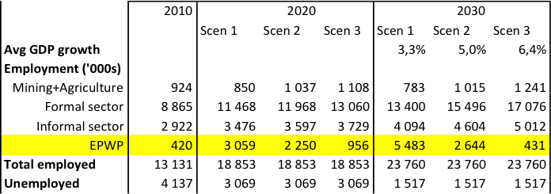
NDP Employment Scenarios
NDP proposes that public employment programmes target 2 million FTEs by 2020 or about 50% of unemployed

Slide 5
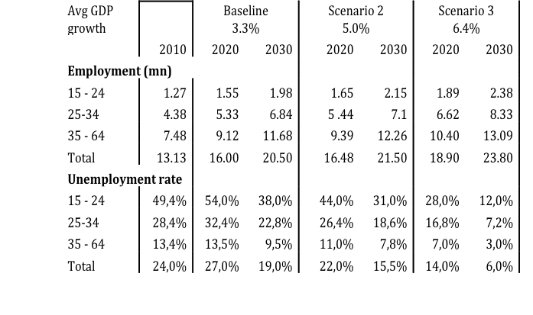
Youth employment projections

Slide 6
EPWP 3 – high level reflections
Emphasis on community services is consistent with the NDP
  Most likely place to create many opportunities with high labour intensity, while also servicing community service gaps and improving community cohesion
  High gender bias and will increase chances of reaching target for women’s involvement
Institutional strengthening is key and welcome emphasis
Budgets and therefore targets fall short of NDP proposals (reaching 530k FTE or 1.2m opportunities in 2018/19)
Unemployment is a policy choice with severe social and economic implications

Slide 7
EPWP design thinking about social sector, community & non-state sector

Slide 8
Central changes to EPWP II and further improvements in EPWP III
Greater attention to community based services – this is likely to be key contributor to job creation if the right model can be found
Higher targets – therefore also seek approach to help get to larger scale
Employment incentives introduced
Decentralised decision making, especially in employment incentive and CWP
Continuous employment possible
Should have impact of strengthening non-profit and community based organisations. This will be critical support for service delivery

Slide 9
Organisational model is central issue
Community Works Programme
Kha Ri Gude – cascade model (1:10:17)
Municipal incentive
Non-state sector incentive – by far the most labour intensive
  Approach to community based services
  Eg of ECD – social sector targets are too low
  Excessive centralisation
Challenge to scaling up =
Excessive top-down controls
Direct linking of state to non-state sector. Excessive admin
Programme complexity
Payment approach

Slide 10
Example of opportunity with public/private mix
Tiger Brands Foundation – DBE partnership

Slide 11
Tiger Brands Foundation – DBE partnership
TBF funded by dividend flow from Tiger Brands – offers financial sustainability and ability to innovate.
Piloted design of school breakfast feeding, includes:
  industrial kitchens installed
  training for food handlers
  high quality breakfast at low cost
  discipline in its delivery
  mobile monitoring
In operation since 2011. Now reaches 38,000 children daily in 62 low income no fee public schools in 7 provinces
Design is highly centralised with small central office, with 7 regional coordinators.

Slide 12
Mobile monitoring – major livelihood opportunity
Unemployed youth recruited to monitor TBF breakfast, and Govt NSNP lunch, on a daily basis
Information is simple, and collated daily so we can act on it immediately
TBF provides the information to DBE weekly.
The DBE has now expressed interest in expanding this monitoring to its other NSNP schools (more than 20,000 schools).
The TBF has developed a model that would enable these monitors to provide similar services for other purposes. This could expand the paid hours of work and make the opportunity more sustainable
  Monitoring of schools more generally
  Monitoring of other public service delivery
  Entrepreneurial activity – eg selling air time, doing market research etc
One challenge is identifying the employer, and labour law implications

Slide 13
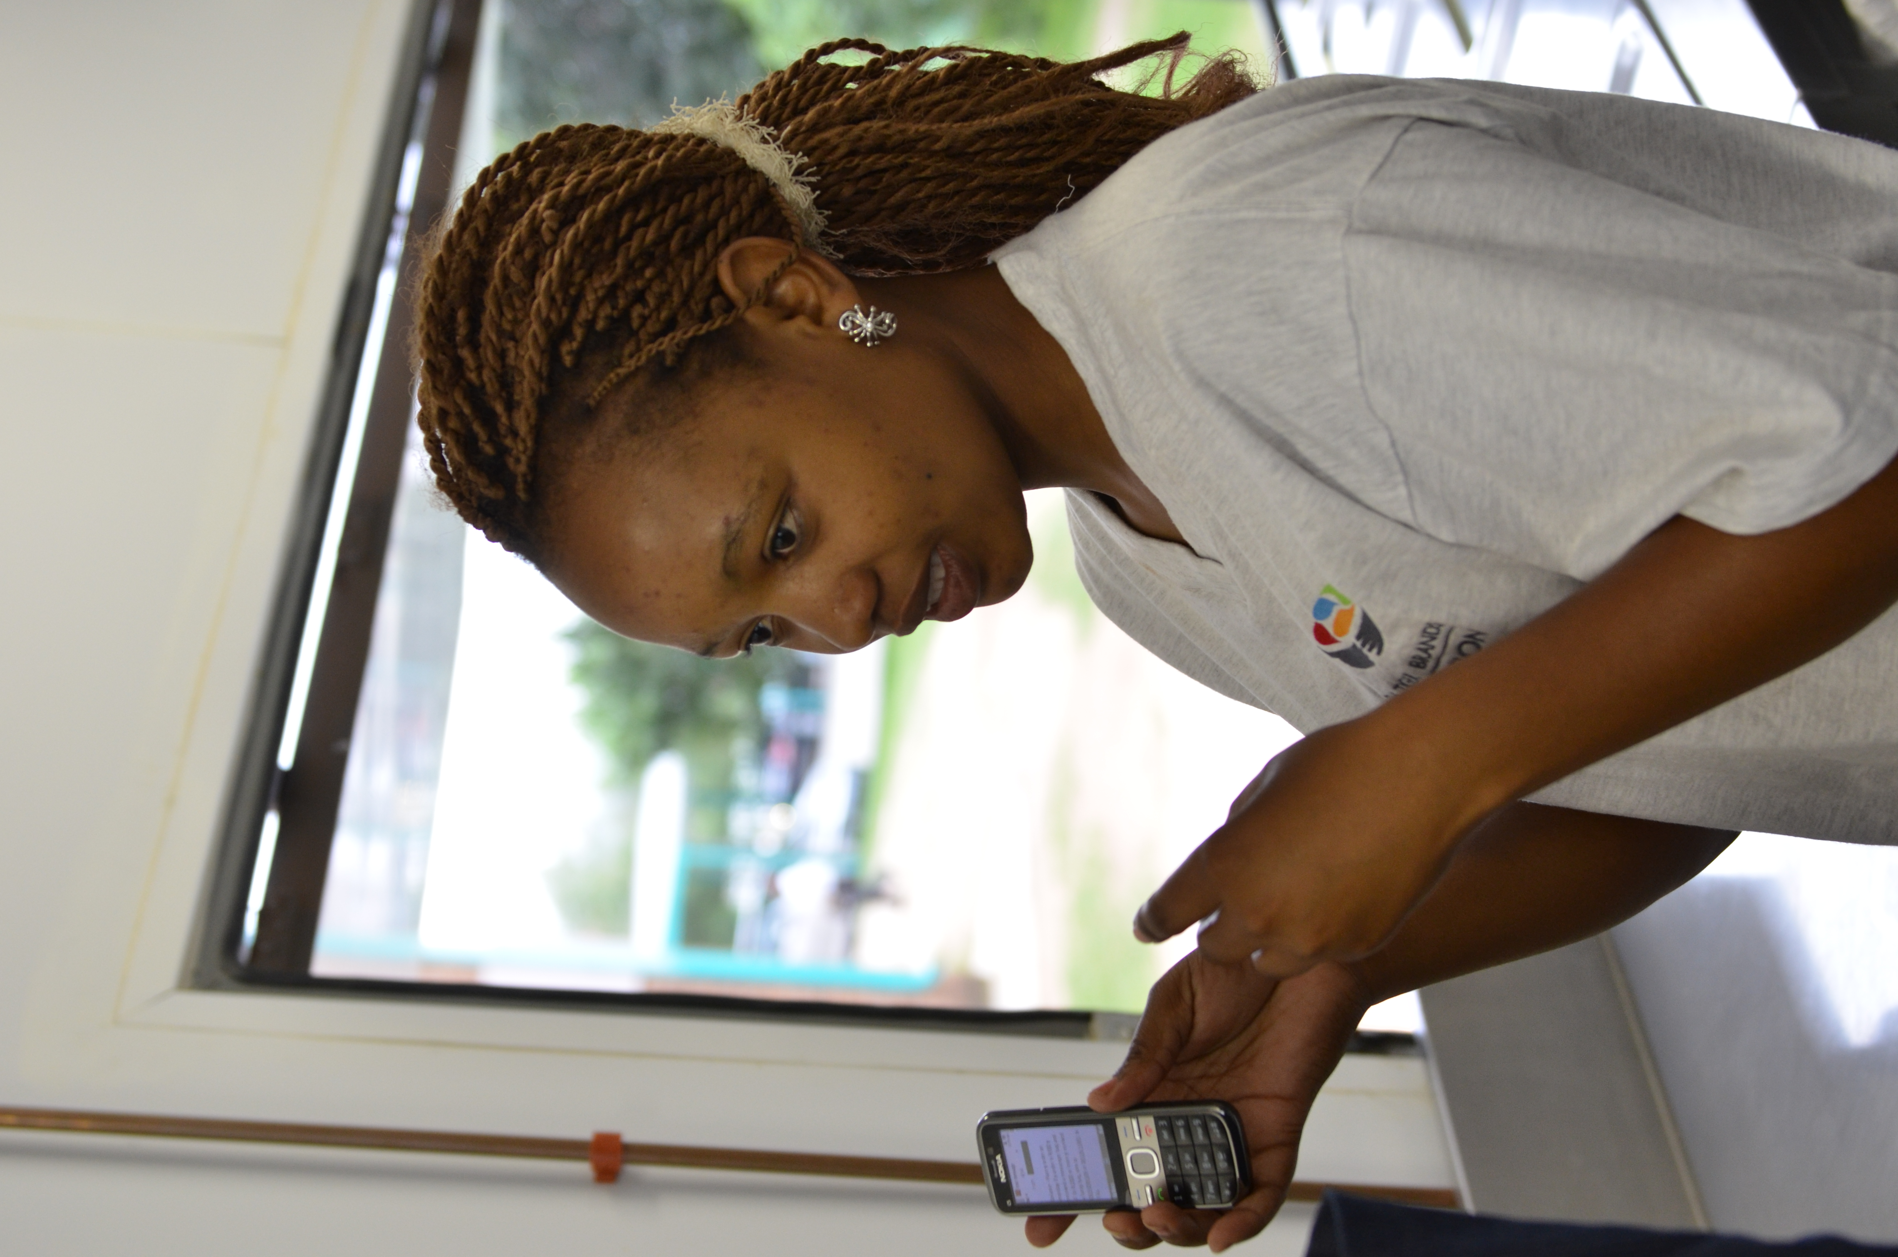
Mobenzi Technology in all TBF schools
Up to the minute real-time reporting
Builds a profile on each project site (school)
Manages school monitors
Empowers the SMT to self manage
Detailed reports on food delivery, food preparation, hygiene, performance & influencing factors

Slide 14
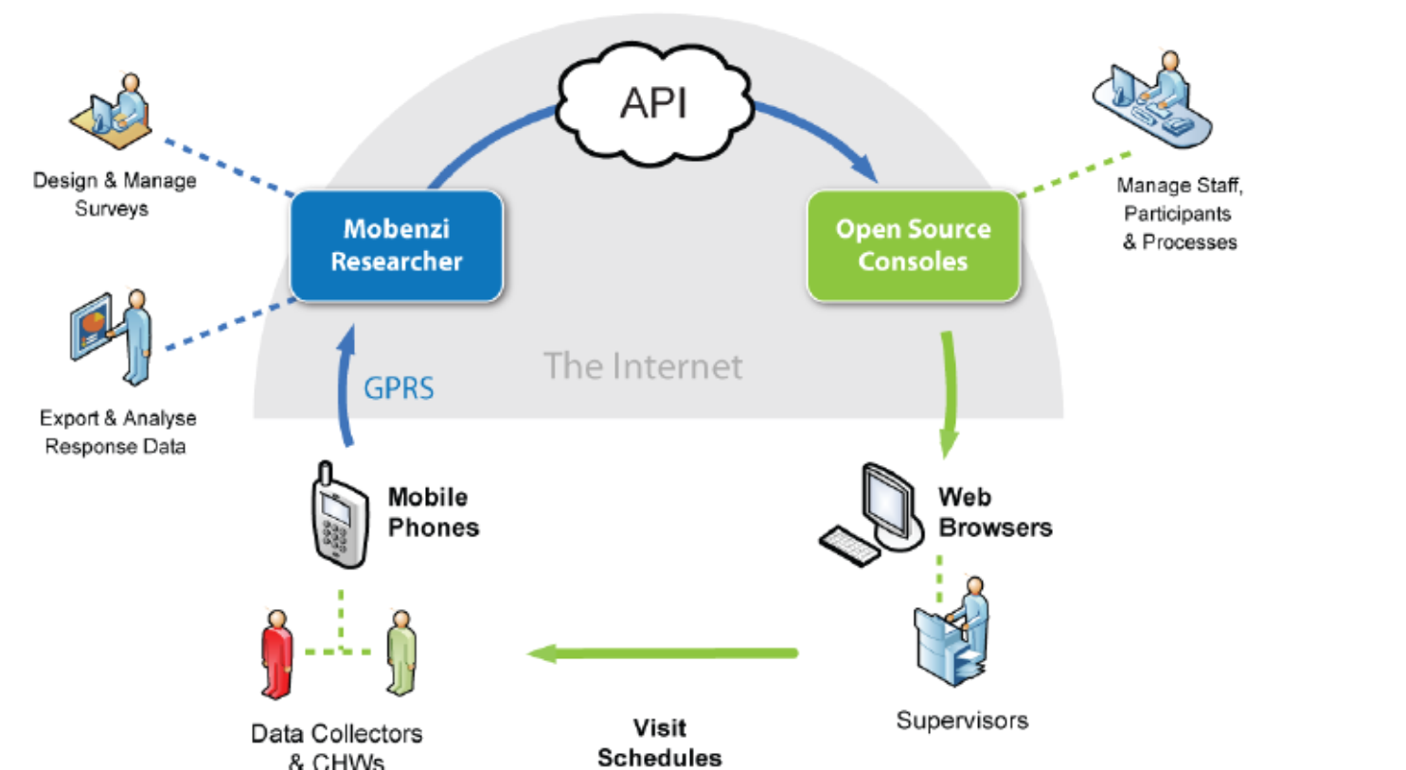

Slide 16
Concluding remarks
Public employment programmes – imperative that they expand
  Probable that largest numbers will be found in community services
There are now a number of good models to build on
Organisational model is key. Whether hierarchy or network model. Appropriate supervisory structure.
Appropriate allocations to admin and intermediary support
The role of the ‘champion’ must become less central.
Ongoing commitment to capacity building on design, implementation and reporting
Creative partnerships between government and private sector can help programme expansion
Approach to labour law will become increasing challenge to epwp where there are continuous employment relations

